Slide 1
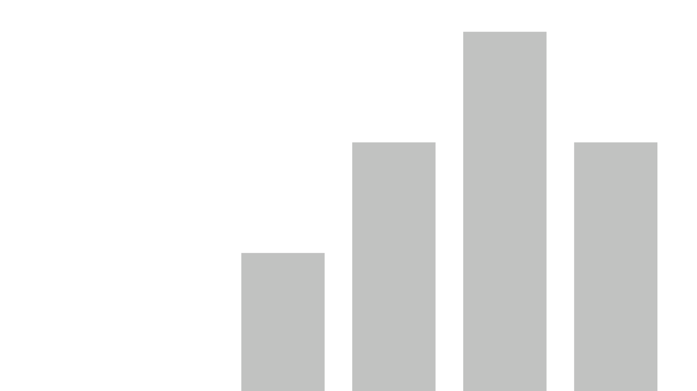

Performance Benchmarking

Slide 2
Contents
Performance Benchmarking Overview
Task Analysis
Performance Analysis
Frequently asked questions

Slide 3
Performance Benchmarking Overview:
The following slides show the overview produced by Telos Analytics after conducting a Time & Motion study. All data in this example is illustrative and not based on real individuals or tasks.
Key Metrics including:
  Number of tasks recorded
  Number of Individuals
  Number of Instances
  Min/Max/Avg. Steps
  Min/Max/Avg. Time
  As users interact these values will change to reflect the selection made
A Scatter Graph shows all tasks plotted by average time versus average steps. This allows the user to see which tasks take the most time and effort to complete. The size of the dots indicate how many instances have been recorded for each task. The bigger the dot the more instances have been recorded and the greater confidence we can have in the average.
The Scatter Graph has two additional levels of drill down which will be shown in the following slides

Slide 4
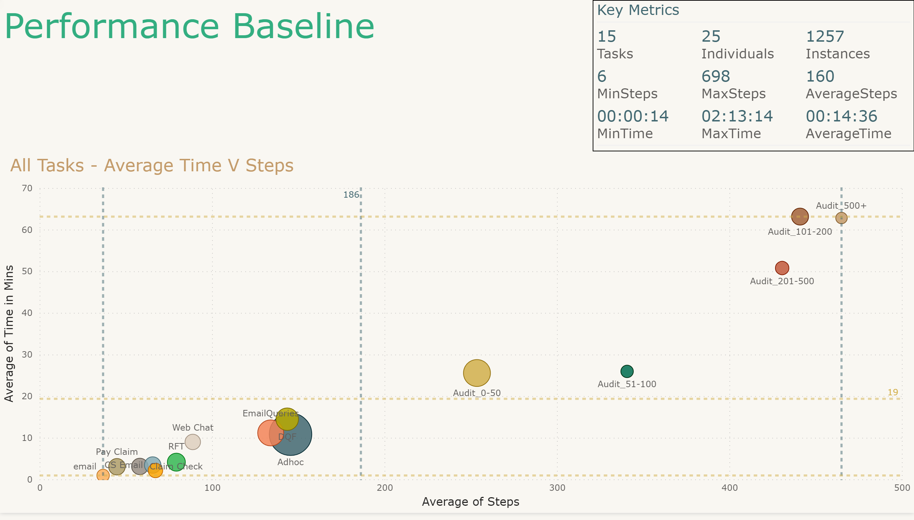
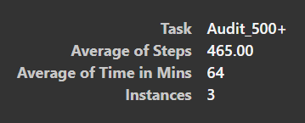
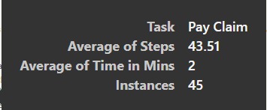
The original report without any filters applied. Note 15 tasks are mapped and 25 individuals have recorded data against these tasks.
The Scatter Graph below is divided into four quadrants using average lines.
Pay Claim is the shortest task to compete. Audit 500+ takes the longest to complete. Surprisingly auditing 100-200 members takes longer than auditing 200 to 500 members.
Hover on the data points on the report to see the additional info shown in black boxes

Slide 5
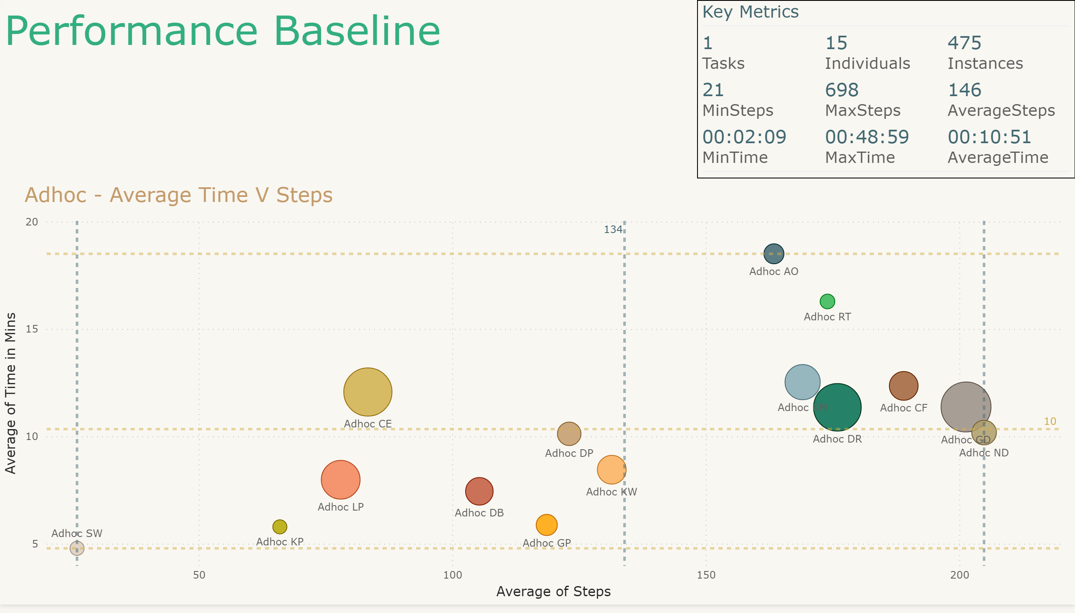

Report at first level of drill down. The task “Adhoc” has been selected. We can see that 15 individuals have completed this task. The dots are labelled with task name and then the initials of the individuals who have completed these tasks.
To drill down make sure this symbol is selected and click on a data point on the report.
This quadrant is the least favourable and indicates the individual is slow at completing the task. They have an above average time but below average steps to complete. Therefore their average step time is high. These individuals may be in need of additional training.
This quadrant represents the best area for improvement. They are generally slow at completing the task but this is (at least partially) due to elongating the process. If we can reduce the steps we should be able to reduce the time to complete.
This quadrant likely contains top performers and as such there is less opportunity for improvement. The process should be examined here to make sure there is no detrimental shortcutting. If the process is sound, it should be used as a basis for ‘one best way’.
This quadrant shows individuals who are quick to complete the task despite having above average steps. They have a very low average step time. The quality of the output should be examined for this quadrant. If the quality is good then reducing the steps will move these individuals towards top performers.

Slide 6
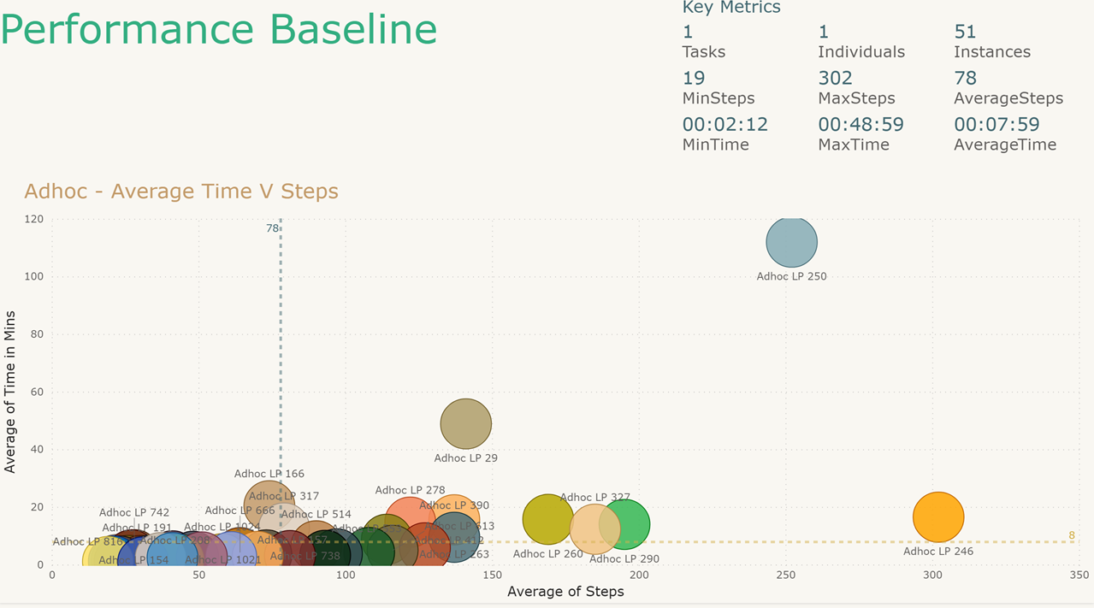
Report at second level of drill down. The task “Adhoc” was selected then the ID “LP”. What we are seeing is the 51 instances that LP recorded for the task “Adhoc”. We can see the Key Metrics now have changed to reflect this. The dots are labelled with the task name, initials of the individual and the unique record id.
We have two outliers here. Using the record ID we can go back to the original recording and check its validity to include or exclude as is relevant.

Slide 7
Task Analysis:
The following slides shows the Task Analysis produced when Telos Analytics conducts a Time & Motion study. All data in this example is illustrative and not based on real individuals or tasks.
Report includes:
  Key Metrics to match overview
  Task Slicer – Showing number of individuals and instances complete
  Scatter Graph showing individuals plotted by average time versus average steps
  Line and clustered column chart showing how individuals Rank on tasks and how many tasks they have completed

Slide 8
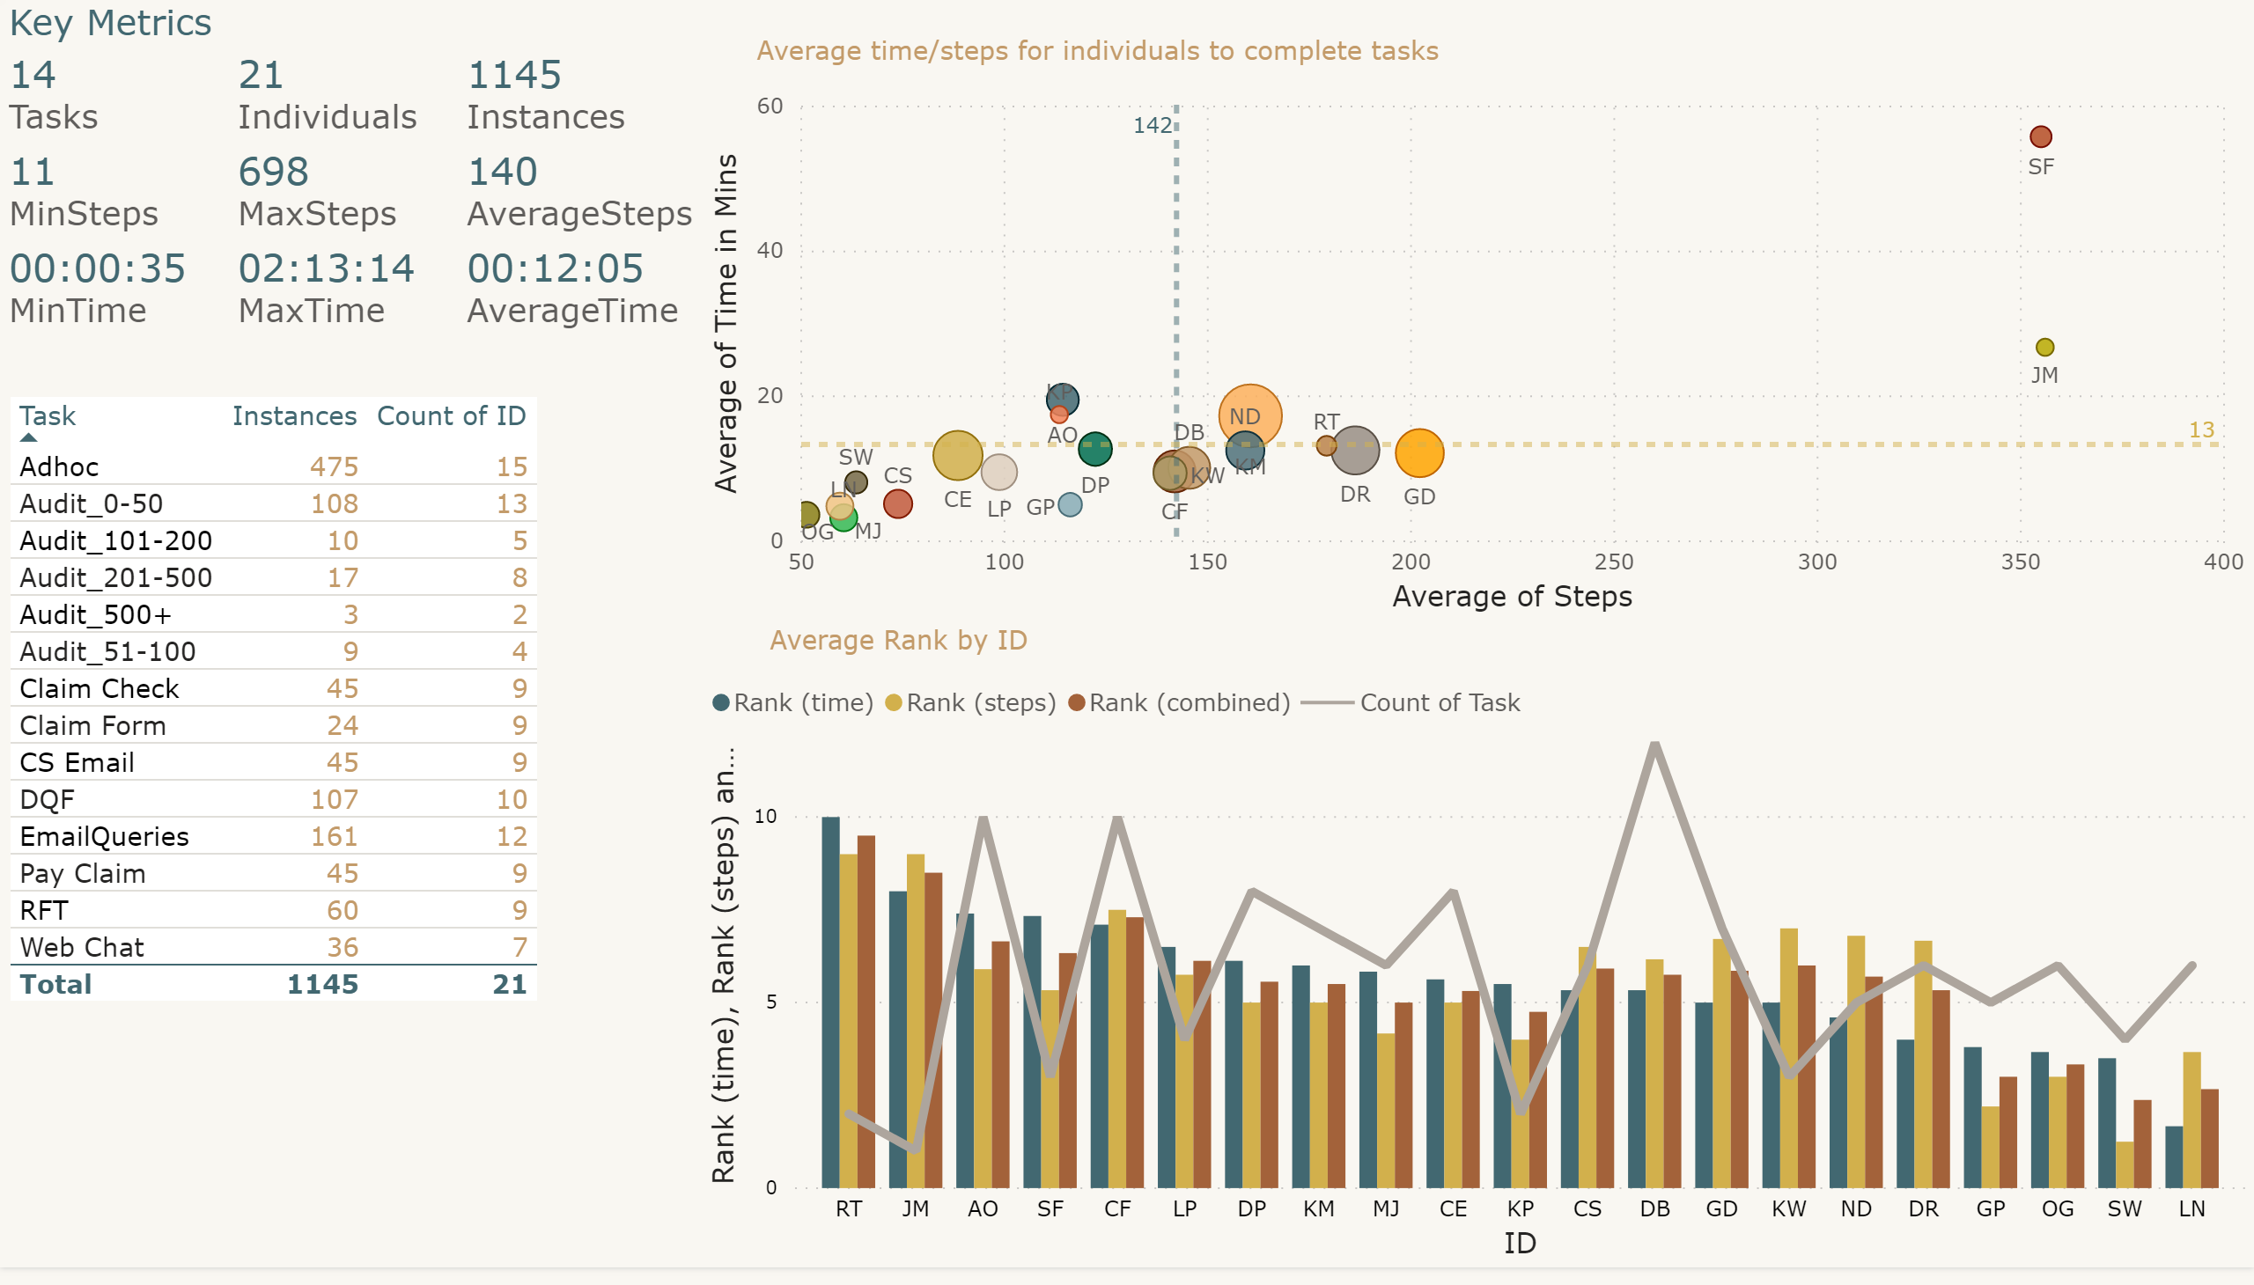
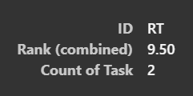
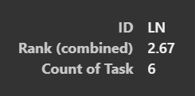
This shows the overall position for each individual for all tasks.
RT has the highest (worst) overall ranking with an average ranking of 9.5 for the tasks they have completed. RT has only completed 2 tasks so could improve as they complete more tasks. LN has the best overall ranking but has only completed 6 of the 14 tasks.
The original report with no selections made.

Slide 9
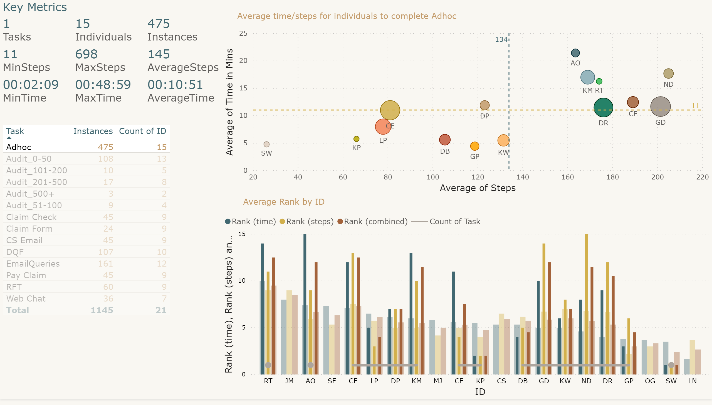
The data for this visualisation has been sliced to “Adhoc”
Slicer has been used to select “Adhoc”
The dark lines show how individuals rank for the value selected in the slicer (Adhoc). The fainter lines show overall rank for all tasks. If the dark lines are longer, it indicates one of the weaker tasks for the individual. Shorter dark lines mean a strong task for the individual. If no dark line present the individual has not completed the task.

Slide 10
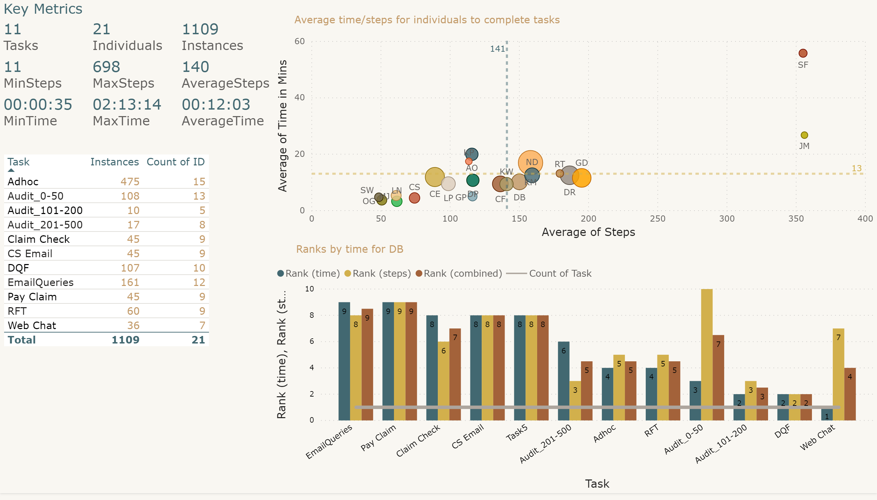
The bottom visualisation has been drilled on the ID “DB”. We see their ranks for all the tasks they have completed. The rank for “Web Chat” is interesting, they are ranked number 1 on time i.e. the quickest and number 7 on for steps. We can see from the slicer that only 7 people have completed the ”Web Chat” task, which means that DB has the highest number of steps. They are quickest on time but with the most steps. With real data this would certainly be something interesting to investigate.

Slide 11
Performance Analysis:
The following slides shows an Example of Performance Analysis that can be produced by Telos Analytics to augment a Time & Motion study. All data in this example is illustrative and not based on real individuals or tasks.
Report includes:
  Department Performance – Showing completed hours and % to target for all individuals
  Team and ID Slicer
  Bar charts showing team totals, team average hours complete, average hours by gender
  Line and clustered column chart showing hours complete for each task versus hours expected for each task. The line shows percent complete versus expected.
  Pie Chart showing % of work complete by gender
  Card showing average hours
  Card showing % to target
The colours on the charts are dynamic, above target is green, above 90% yellow and below 90% red.
The first slide shows the report unfiltered. Then the second and third slides show the difference between selecting a team on the report and selecting a team by the slicer

Slide 12
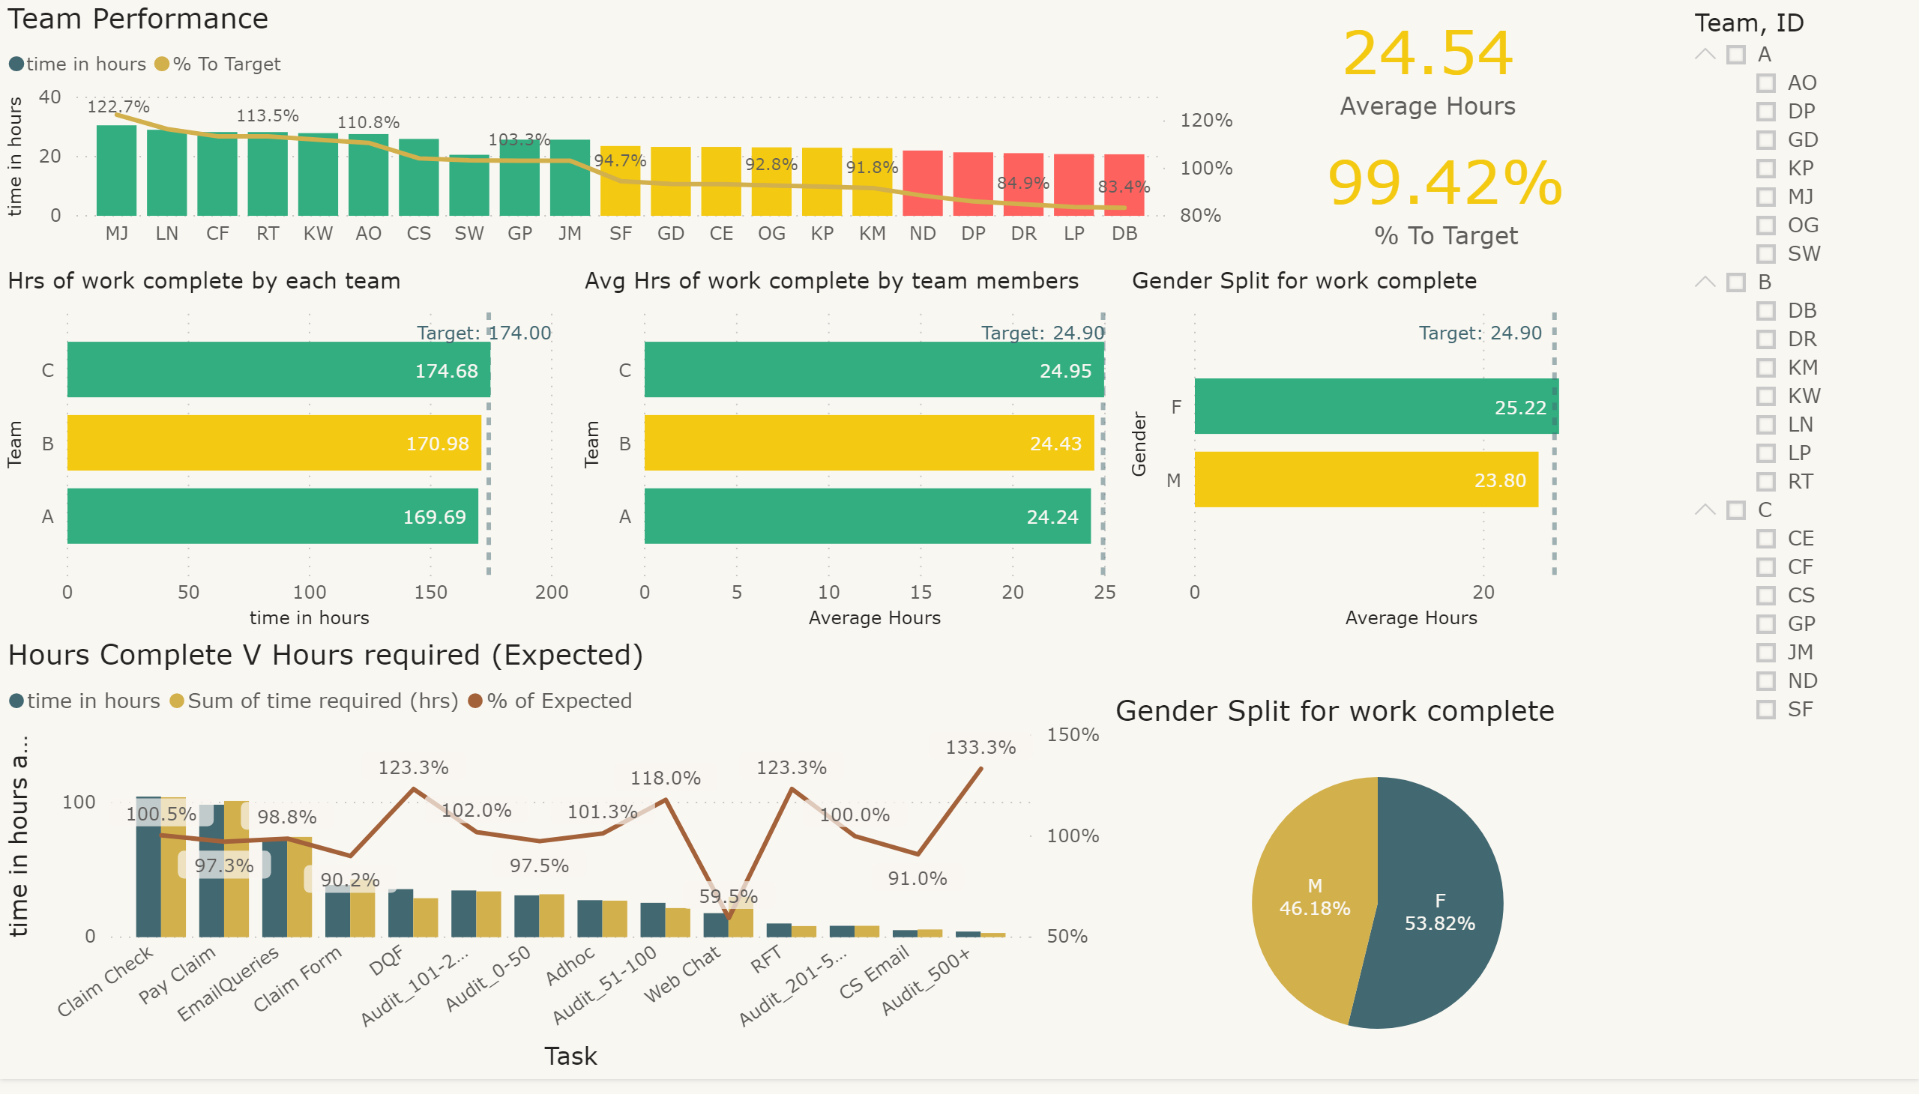

Slide 13
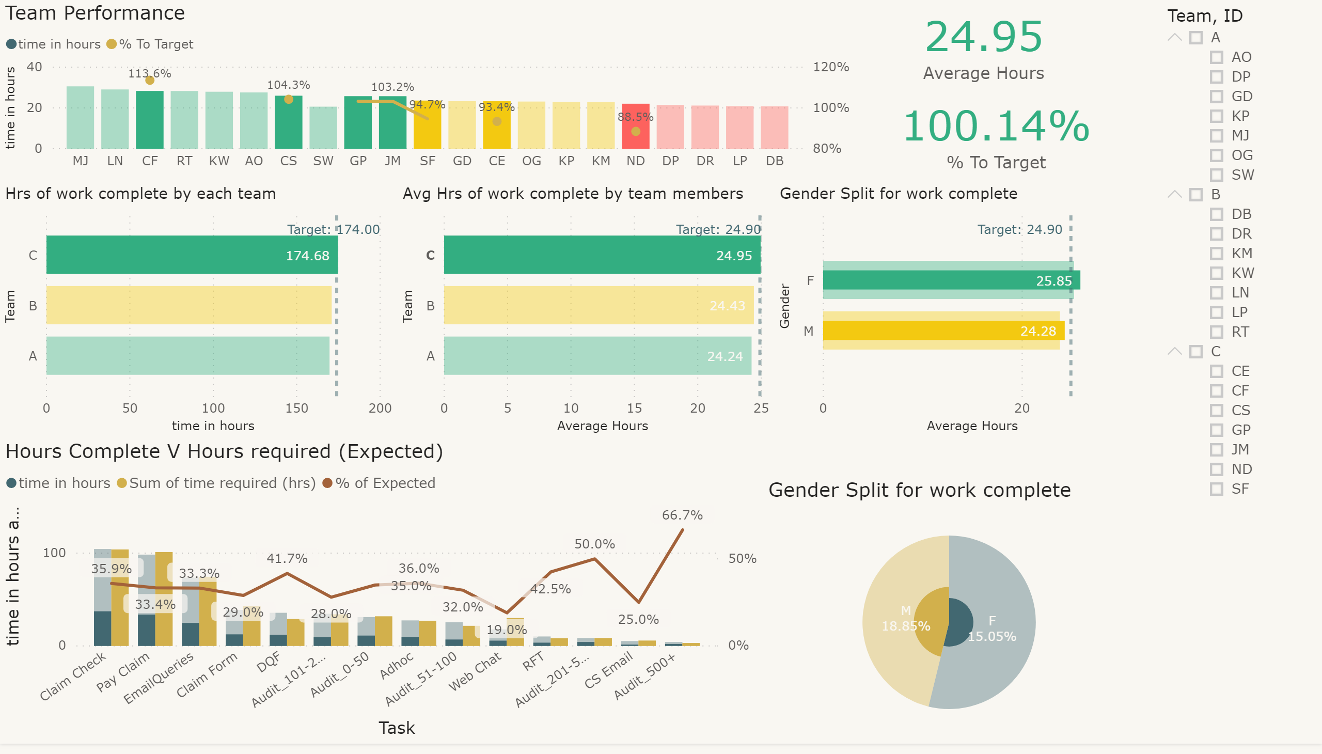
Team C has been selected by clicking on the bar for team C below.
Any visualisation that has multiple values will go dark for elements that are represented by Team C and faint for elements not represented by Team C.
Single value visualisations like the two cards showing “Average Hours” and “% To Target” are specific to the selection “Team C”

Slide 14
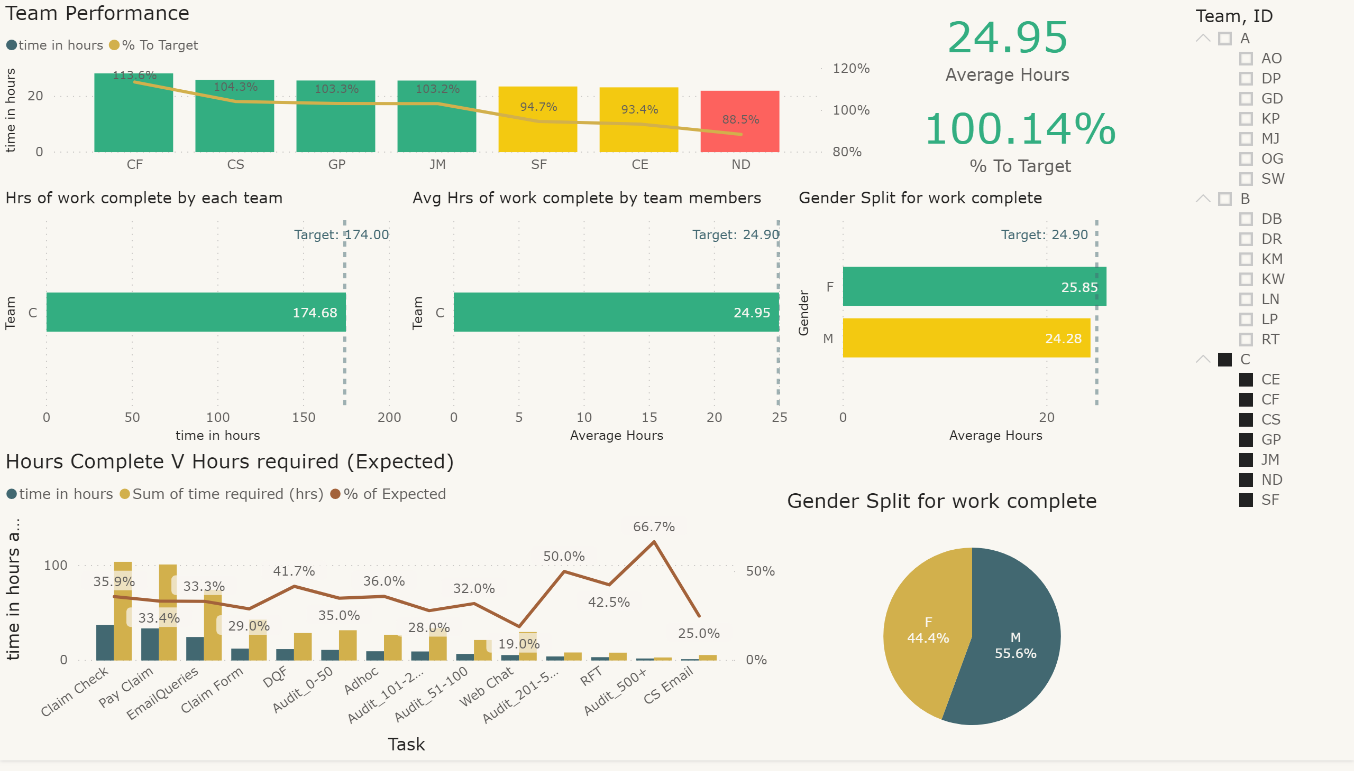
Team C has been selected using the slicer. The report now only shows data specific to Team C. The flexibility to do both allows users to either focus solely on their own team or benchmark how their team is performing against other teams in the organisation.

Slide 15
Frequently Asked Questions:
Q1. What does a Telos Analytics Performance Baselining study involve?
You decide which tasks you want to analyse, these tasks are recorded by your team as and when they occur in their normal working day. We then turn these recordings into data and ultimately MI illustrated in this pack. For the recording we use software already built into Windows PC’s so there is no additional cost for software. As the tasks are recorded as they happen it means very little impact to the operation while the data is gathered. The whole process can be completed remotely, just securely send us the files and we’ll do the rest.
Q2. How many recordings are required for each task?
Generally the more recordings the better, we would not recommend anything less than 10. Some tasks happen very infrequently so getting a large number of recordings may prove tricky. In these cases we may need to boost the numbers by doing “dummy” recordings.
Q3. How many people should be involved?
For the best results, we recommend doing the same number of recordings for each task for each individual that works on the task. If this is not possible you should try for a good cross section, otherwise your timings could be skewed by quick or slow workers

Slide 16
Frequently Asked Questions:
Q4. How long will the process take?
The recordings will be the most time consuming element, this can remain completely in your control allowing you to dictate the pace. Many clients however, prefer us to project manage it for them and drive things along to an agreed timeframe. The analysis is relatively straight forward and we aim to have it complete within a week of the recordings being complete.
Q5. How much does it cost?
The overall cost will depend on a number of factors and we recommend getting in touch and having a conversation. The cost for analysis is known and works on a sliding scale – see the table below for examples.
#Tasks | Total Cost
1 | £500
5 | £1500
10 | £2000
20 | £2500
30 | £3000

Slide 17
Frequently Asked Questions:
Q6. What can the data be used for?
Most Clients undertake this exercise looking for help with process improvement but the data once you have it, can be used in many different ways. Below is a list of common examples all of which Telos Analytics can help you with:
Creation of accurate resource models
Performance reporting
Business Cases to initiate change
Benchmarks before major change with a secondary analysis after the change to show benefit realisation
Creation of Service Cost Models
Q7. Can you create a Continuous Improvement Framework using this data?
Yes absolutely, we specialise in Continuous Improvement below is a blog post that explains how.
https://www.telosanalytics.co.uk/post/contact-drivers-v-contact-outcomes

